Slide 1


NGĀTI WHAKAHEMO
CLAIMS TRUST
INFORMATION HUI
TREATY OF WAITANGI CLAIMS
WAI 1471 & WAI 2536
PUKEHINA MARAE, 15 FEBRUARY 2025
MAKETU COMMUNITY HALL, 8 MARCH 2025

Slide 2

Ko Te Pare o Te Rāwahirua te maunga
Ko Pongakawa te awa
Ko Maruahaira te tangata
Ko Ngāti Whakahemo te iwi

Slide 3
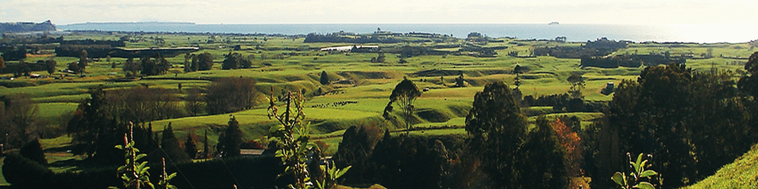
TE PAEPAE ROA O NGĀTI WHAKAHEMO
Mai Pokare i te rāwhiti ki Ngāwhara i te uru mai Pongakawa i te tuawhenua ki Motunau kei waho i te moana
TIHEI MAURIORA!

Slide 4
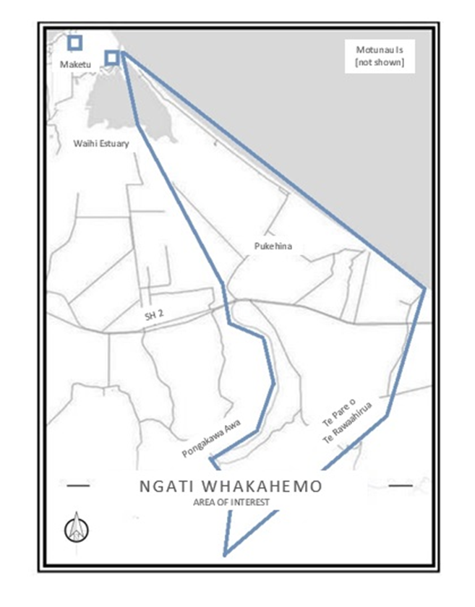
AREA OF INTEREST
Ngāti Whakahemo are a distinct Iwi with clearly defined tribal boundaries and customary interests
Each generation continues to identify with the landscape and its sculpted spaces intimately by name, history and personal familiarity

Slide 5
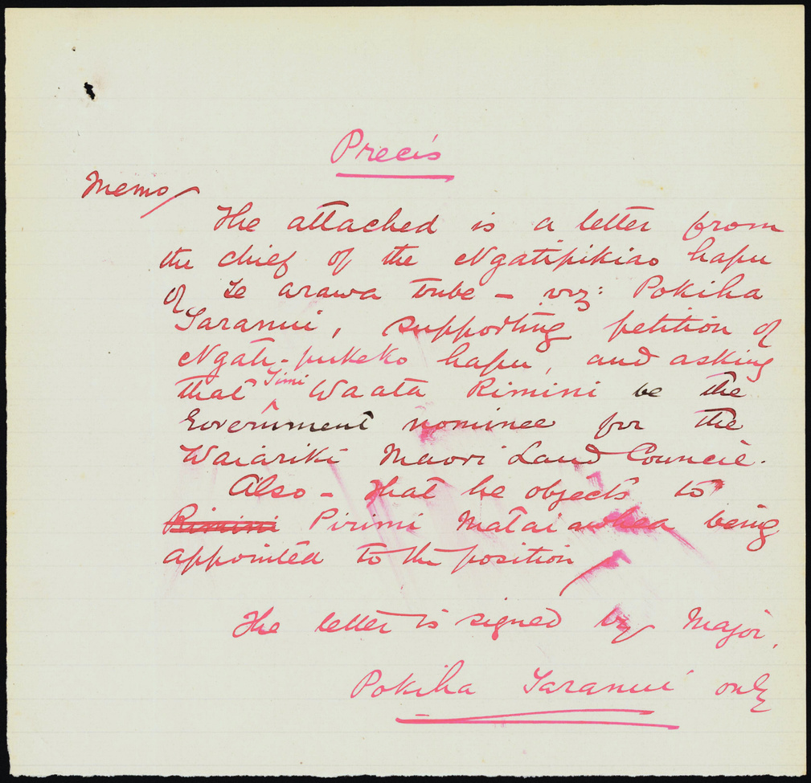
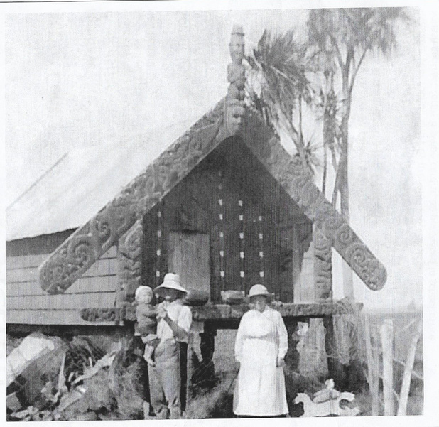
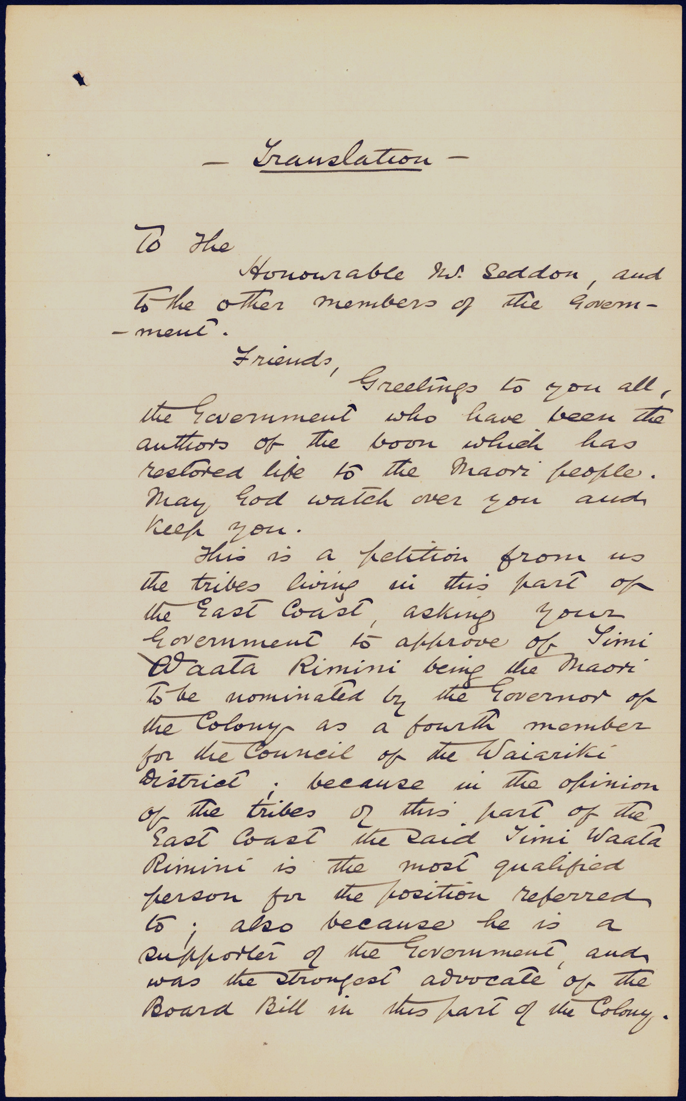
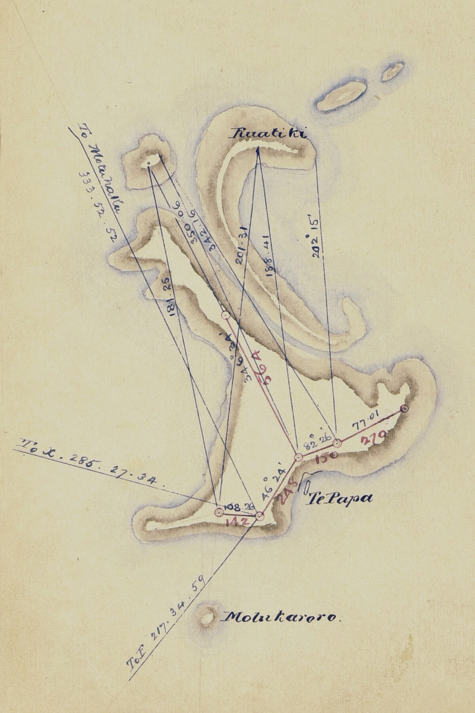
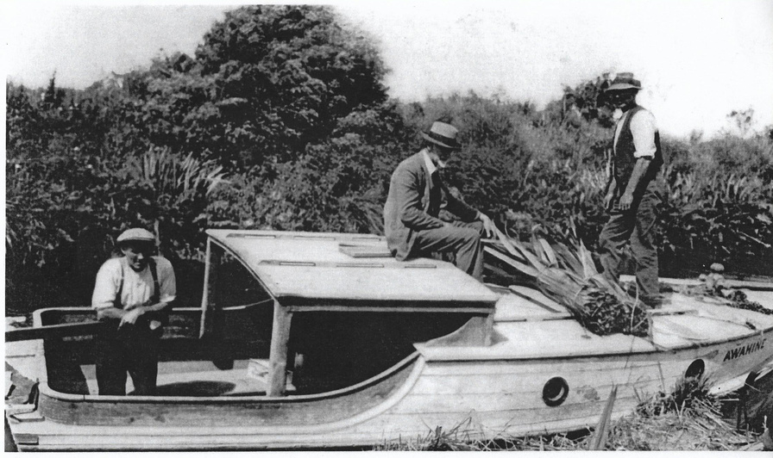
Te Hītori o
Ngāti Whakahemo

Slide 6
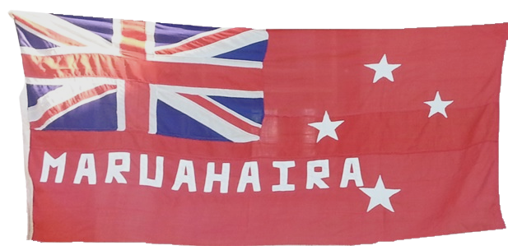
THE DESCENT OF MARUAHAIRA
Kahungunu
|
Kahukuranui
|
Maru-te-reinga
|
Tamatea Tokinui
|
Maruahaira

Slide 7
TRIBES IN OCCUPATION AT PUKEHINA
AT THE ARRIVAL OF MARUAHAIRA
Waitaha-turauta
Te Raupo-ngaoheohe
Te Rarauhe-tarakiruki
These tribal groups had their origins from pre-arrival of Te Arawa and Mataatua waka, the latter two being descent groups from Te Tini o Toi

Slide 8
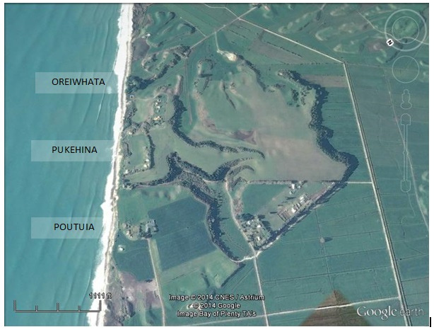
ARRIVAL AND CONQUEST
“Between the strength of the paddles and the force of the waves, the canoes were quickly rushed ashore. They flew in amongst the numbers of men standing in the water. Ah, it was like the strong current of the flood-tide dashing on the coast!”
Timi Waata Rimini
The fall of Pukehina, Oreiwhata, and Poutuia Pa
March 1893

Slide 9
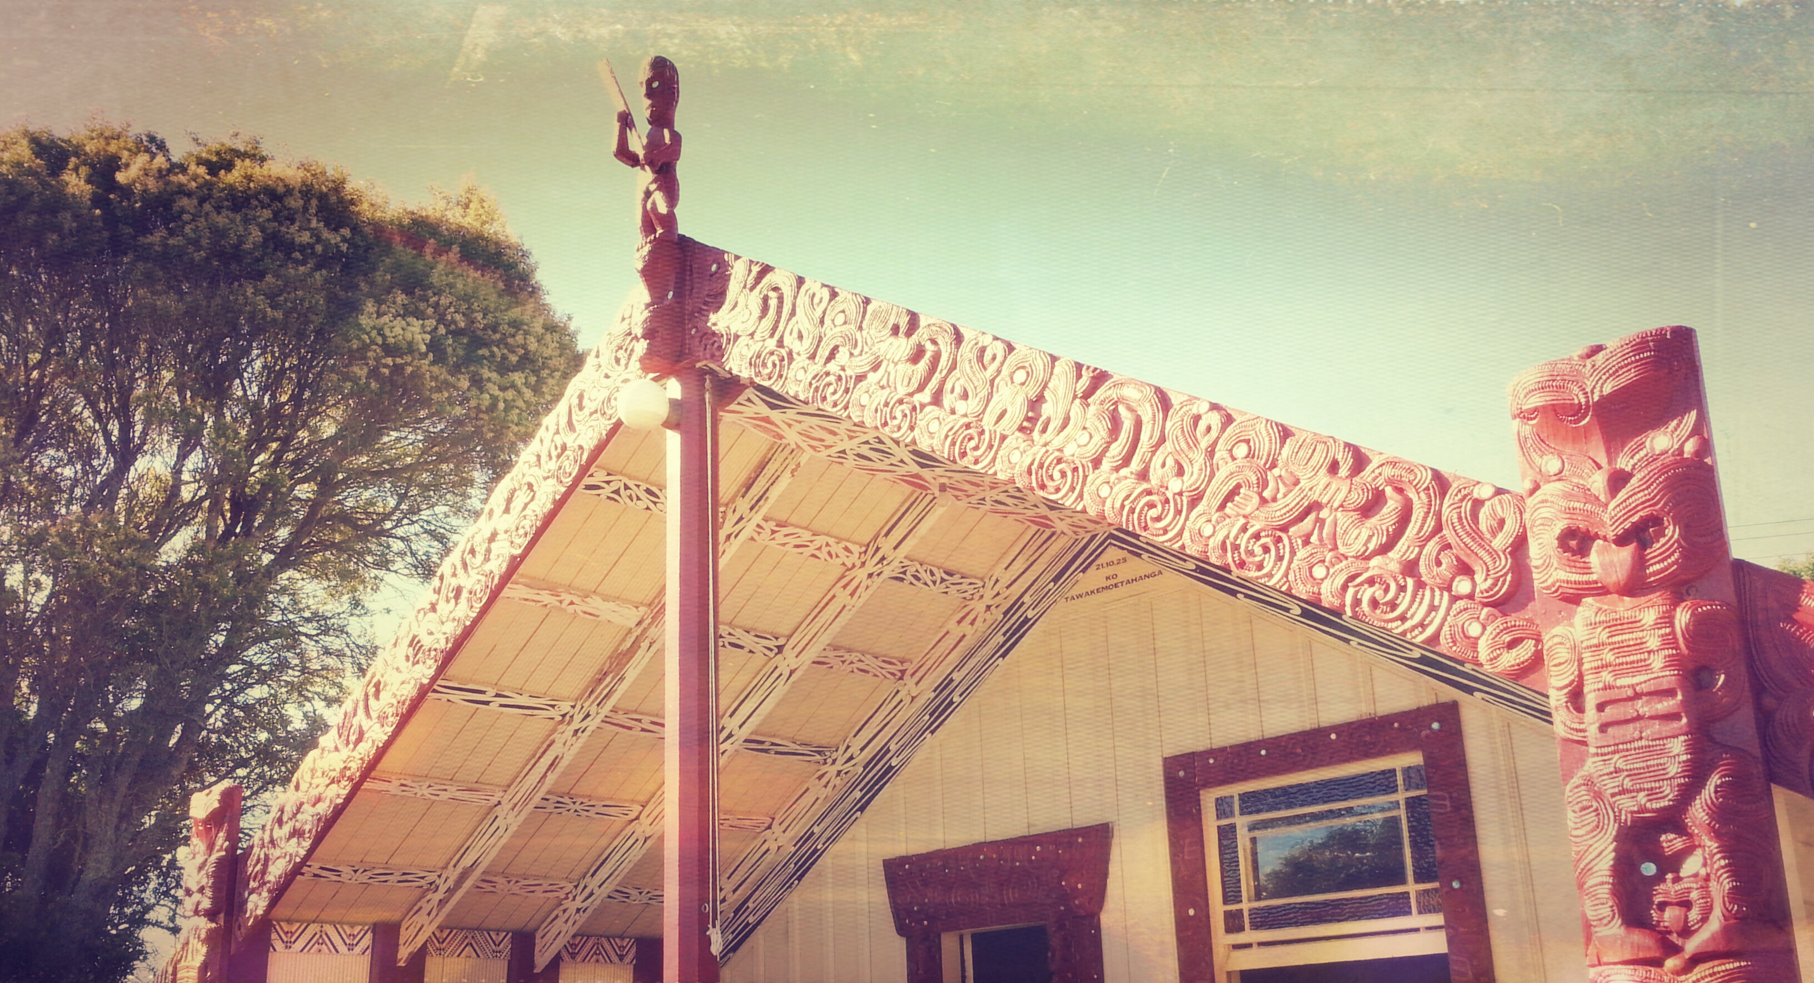
THE DESCENT OF MARUAHAIRA
Maruahaira
|
Maraika
|
Kaiakau
|
Te Ingo
|
Paretira
|
Tirangi
|
Ngamakini
|
Te Awhe

Slide 10
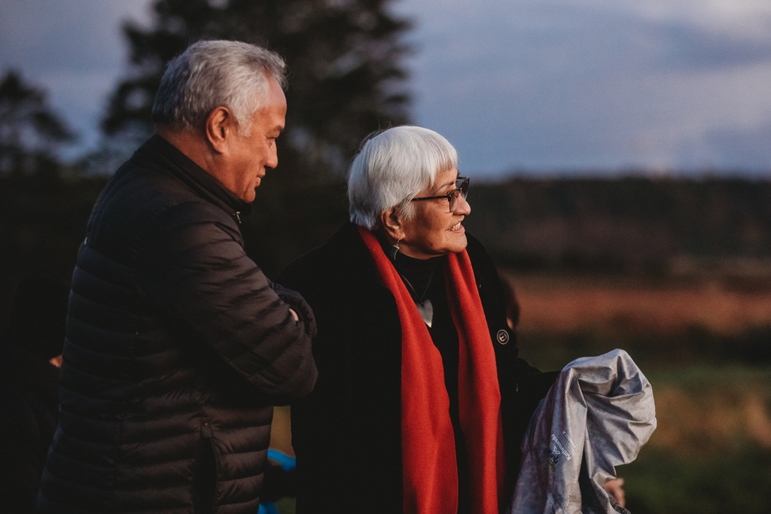
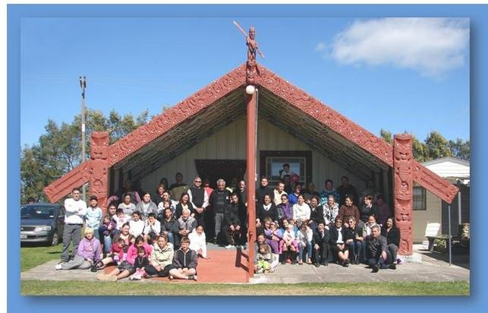
KO TE MAURI O TE WHENUA, KO TE MAURI O NGĀ TŪPUNA
This land has supported Ngāti Whakahemo for more than 15 generations, starting with Maruahaira and encompassing seven generations of harmony, from Maruahaira to the passing of Te Awhe. It continues to nurture us even today.

Slide 11
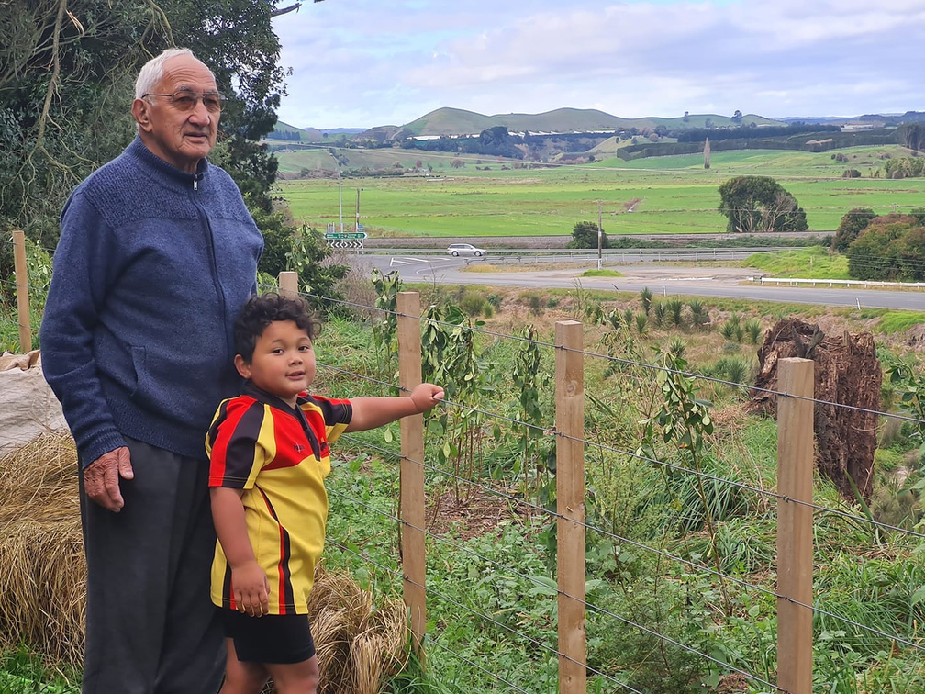
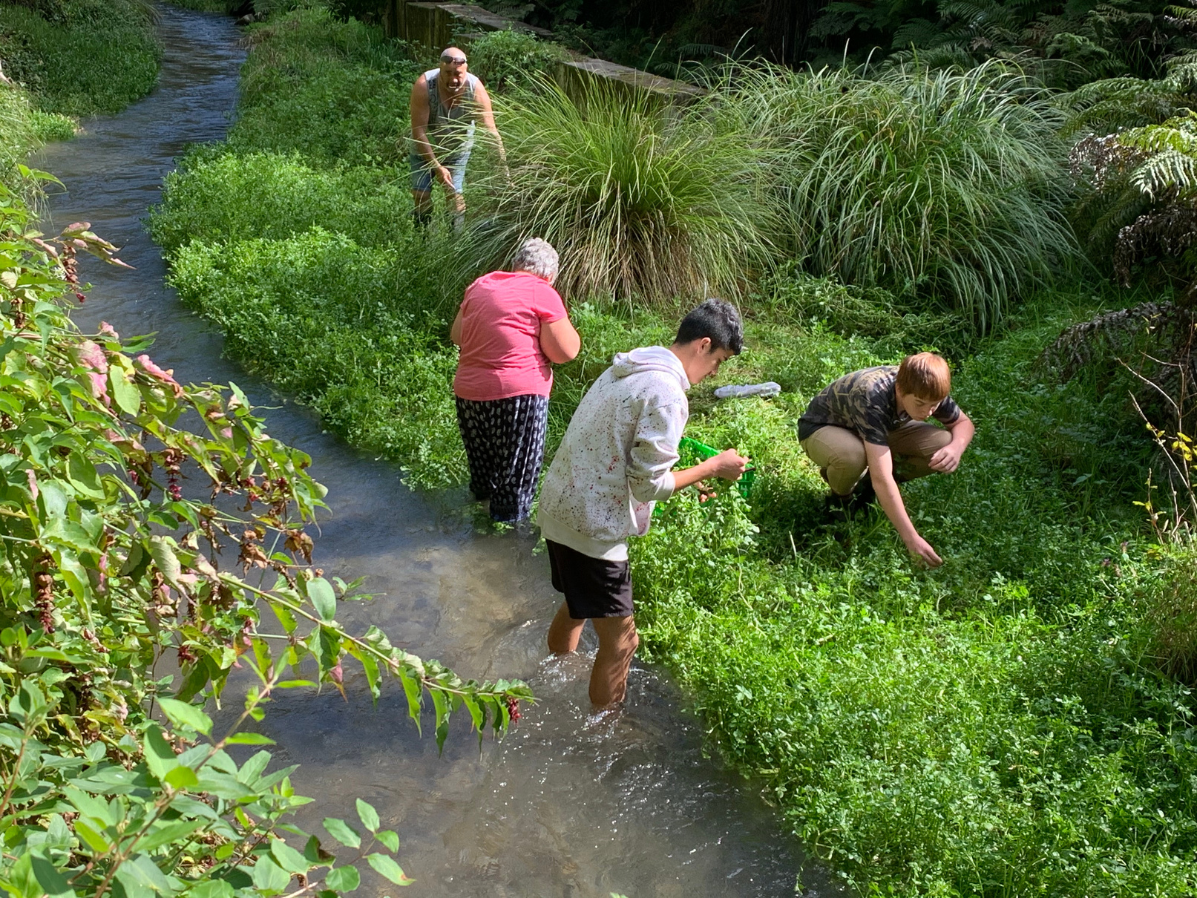
KO TE MAURI O TE WHENUA, KO TE MAURI O NGĀ TŪPUNA
For more than 15 generations, we have called this whenua home, and every square inch has played a vital role in our well-being

Slide 12
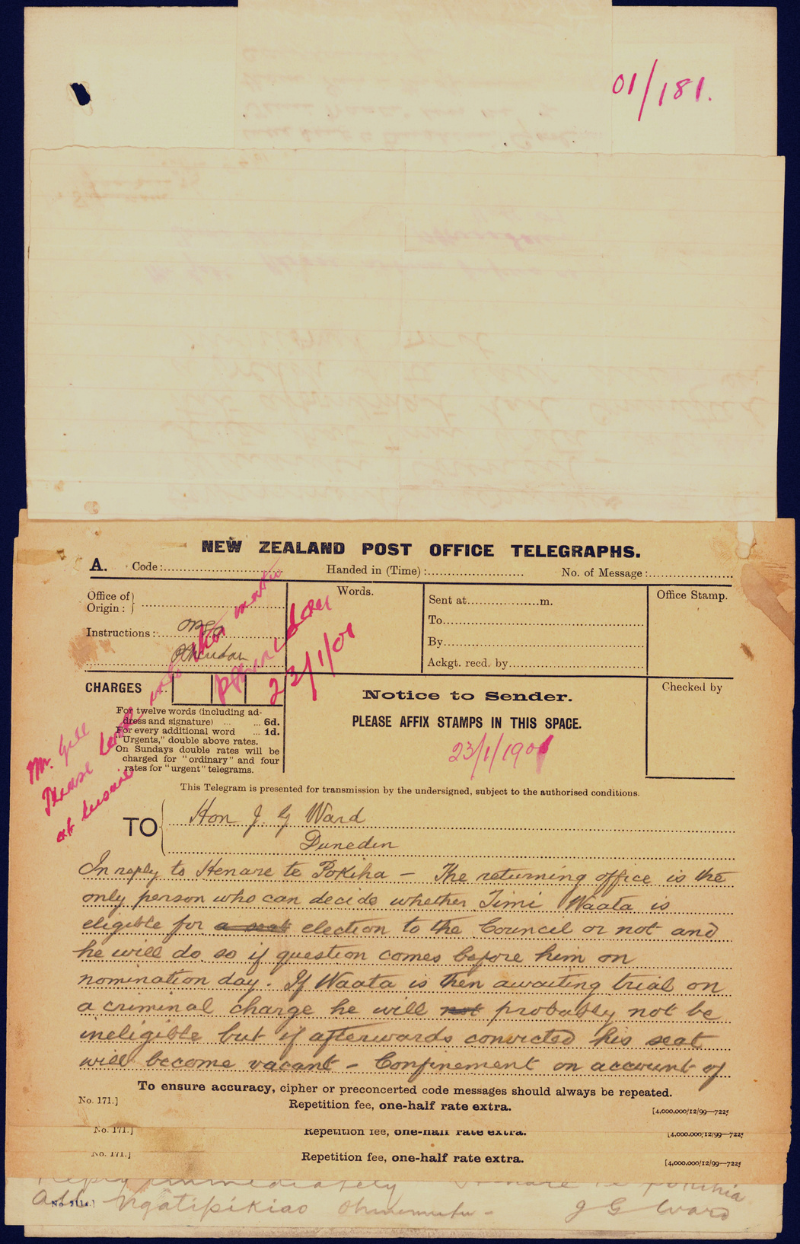
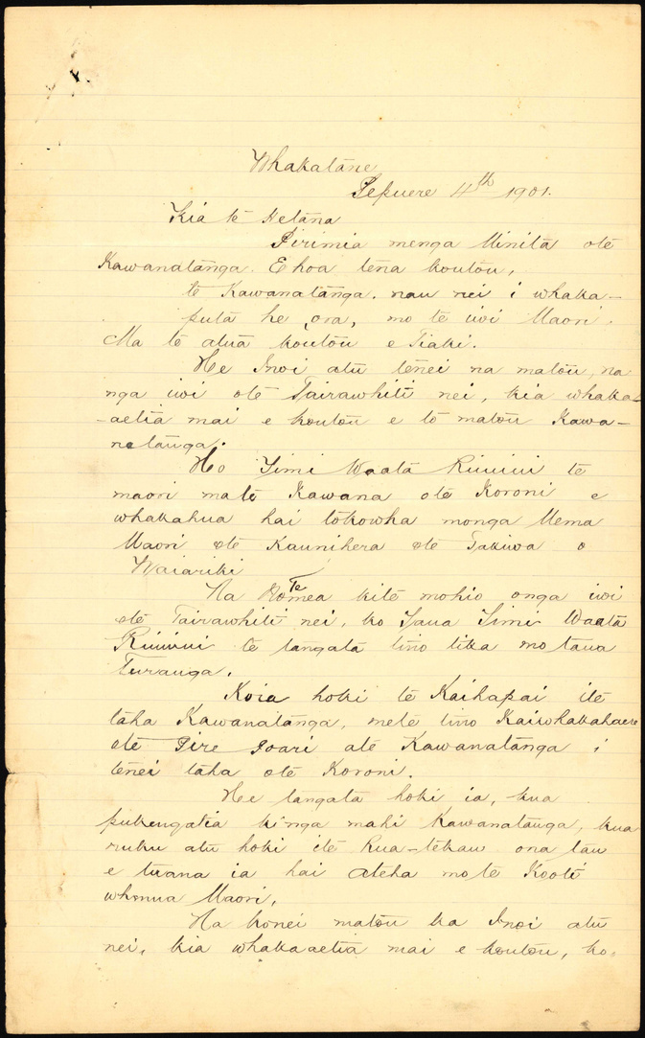
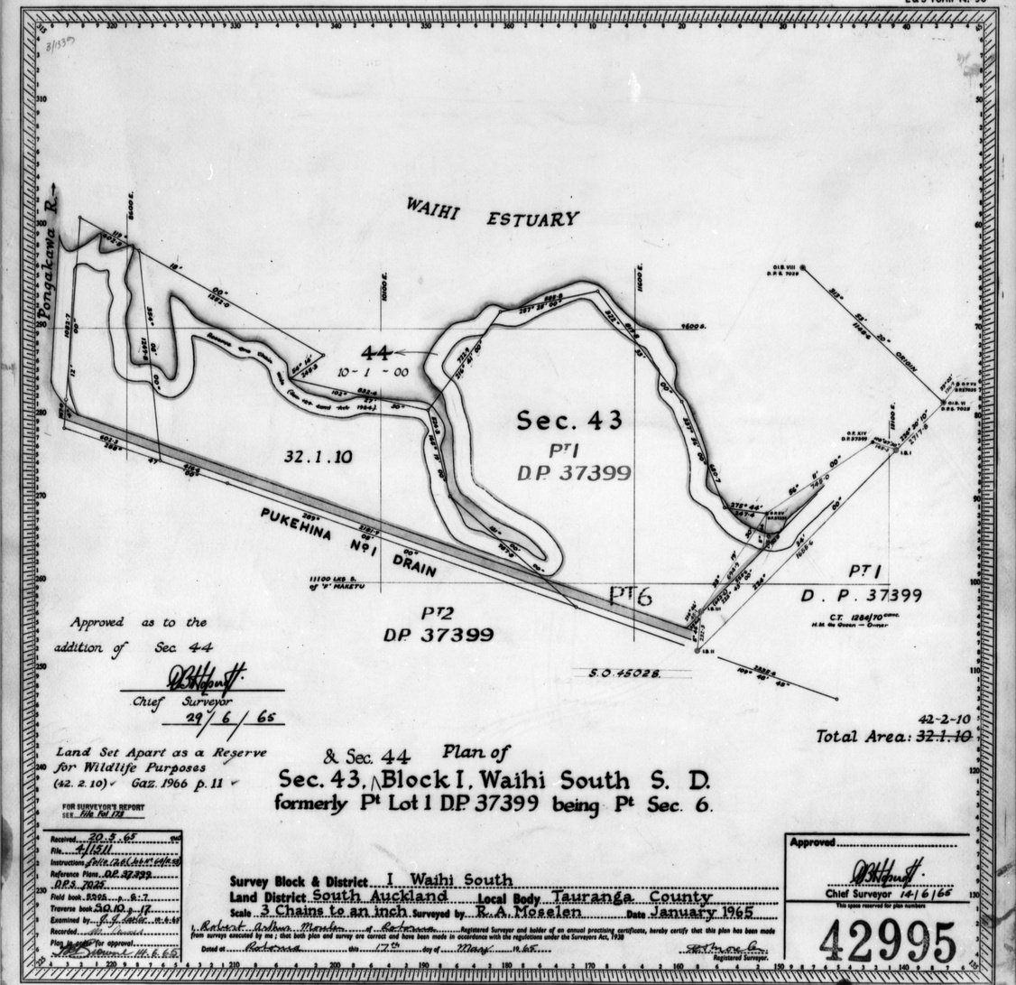
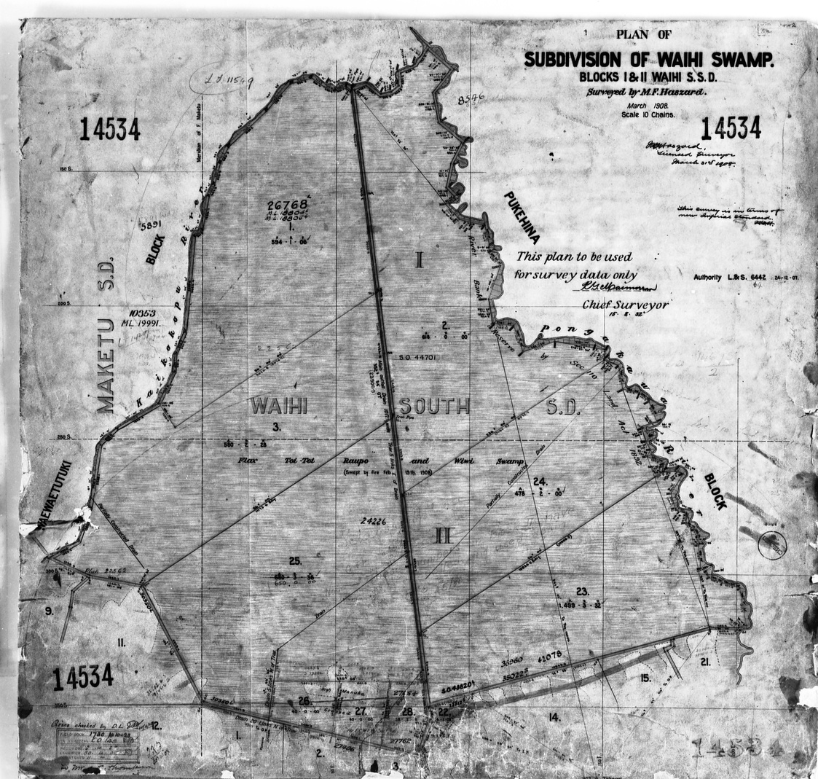
The Native Land Court Experience
1878 -1902

Slide 13
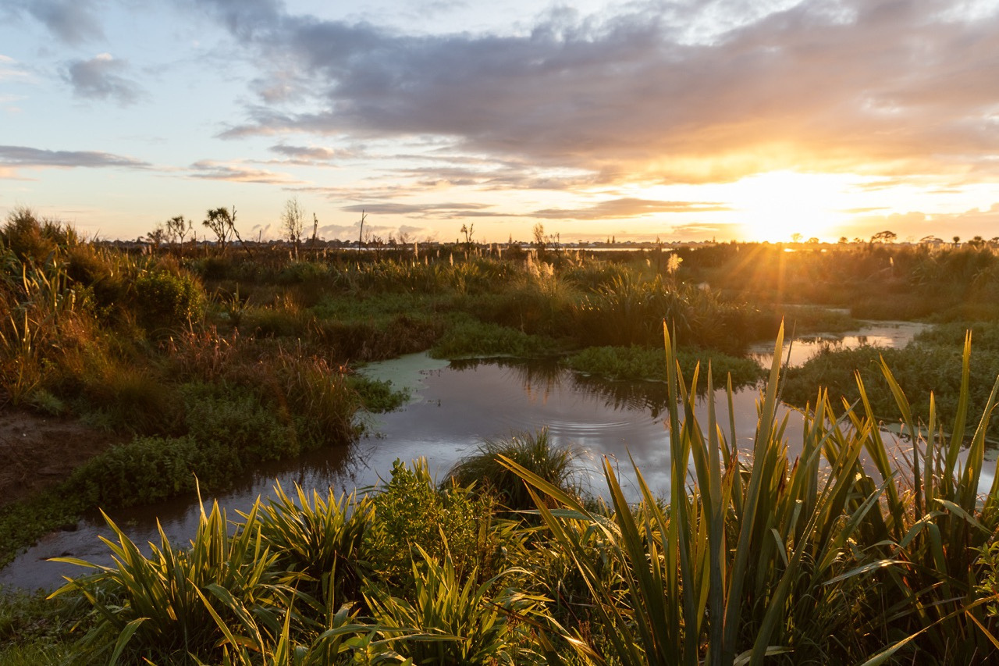
“I KNOW THIS LAND”
“I know this land. I have a claim to it under Ngāti Whakahemo hapu. I claim through ancestry, conquest, mana and permanent occupation. My ancestor is Maruahaira.”
Mita Tahoka
Native Land Court, Maketu
8 Feb 1884

Slide 14
NATIVE LAND COURT 1878 TO 1902
Land interests were awarded to Ngāti Whakahemo as a result of a series of Native Land Court hearings from 1878 to 1902
A Judgment of the Native Land Court in February 1888 confirmed the decision made in 1878 as part of the Otamarakau hearing that Ngāti Whakahemo held mana whenua over Pukehina

Slide 15
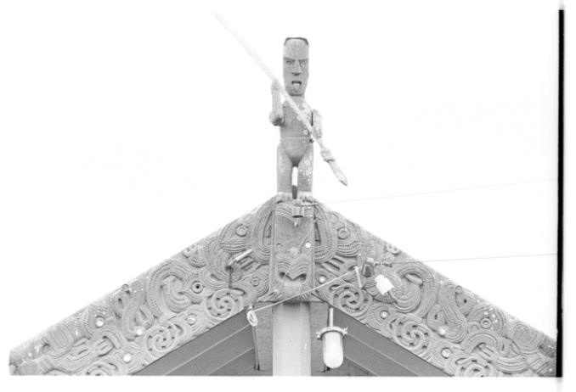
BASIS OF COURT DETERMINATION
Based upon:
  the conquest by Maruahaira
  continuous occupation by his descendants through his son Maraika

Slide 16
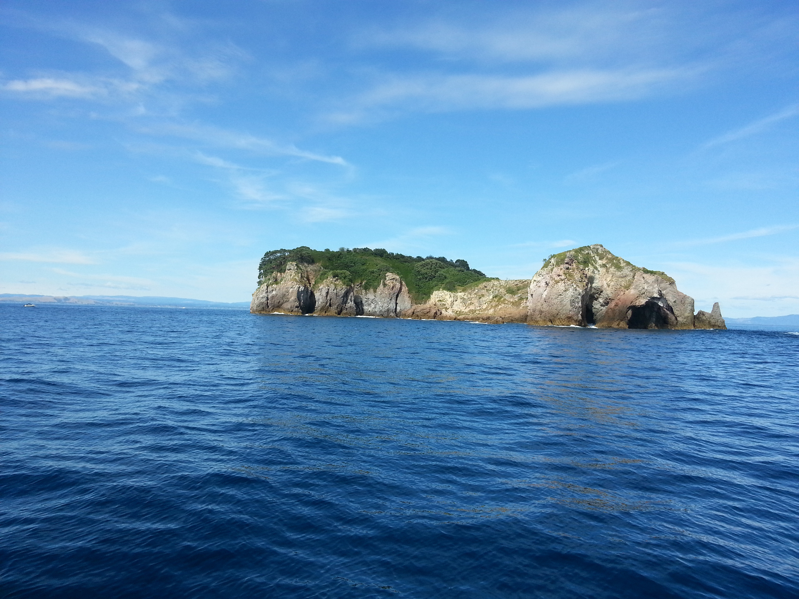
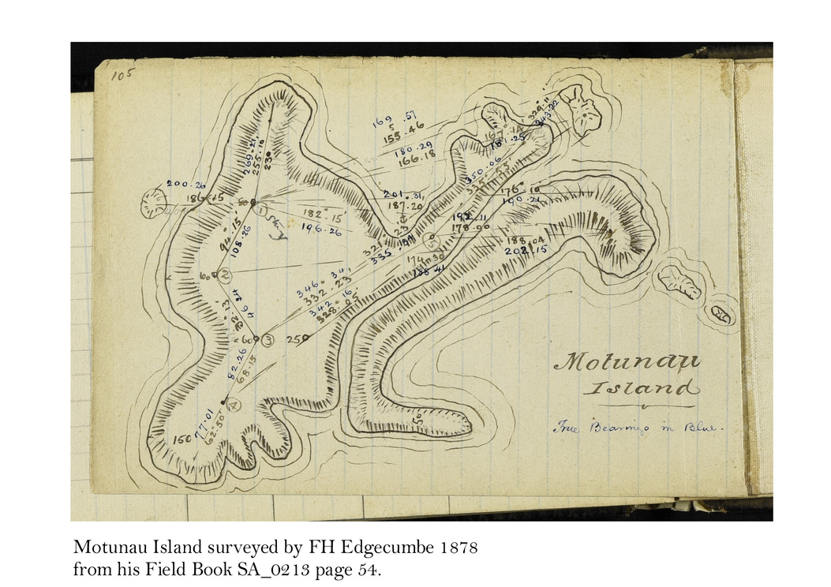
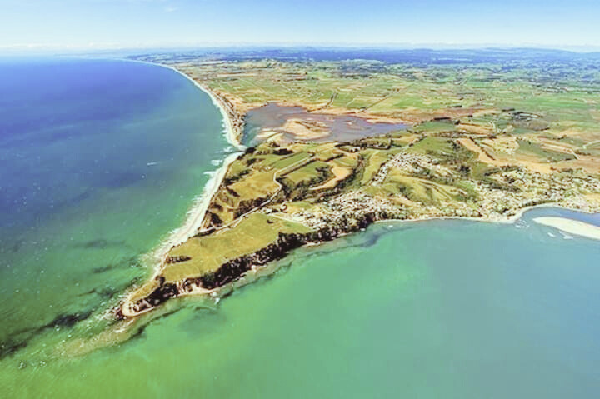
INTERESTS BEYOND THE PUKEHINA BLOCK
Other interests awarded through the Native Land Court are located at
Paengaroa
Maketu
Motunau Island
Motiti Island

Slide 17
INTEREST DERIVED THROUGH OTHER LINES OF DESCENT
Ngāti Whakahemo do not have any interests (today) at Pukehina derived from any other line of descent

Slide 18
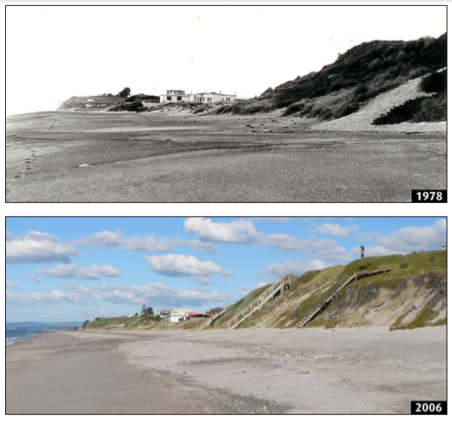
TE TANGO WHENUA – POST 1903
In 1878, more than 10,000 acres were tuturu Whakahemo lands. In 1902, Title to 8,356 acres was awarded by the Native Land Court. It quickly became subjected to Crown and private purchasing.
Today, less than 1,500 acres
remain as Ngāti Whakahemo
land

Slide 19
Waitangi Tribunal (Te Arawhiti) Journey
JOHN KONING
BARRISTER
COMMERCE LANE CHAMBERS

Slide 20
CLAIM BACKGROUND
  In 1998 Ngāti Whakahemo agreed to file claim
  In 2008 Murray and Mihi Anaru filed WAI 1475 and Hemi Anderson filed WAI 2536
  Between 2008 and 2014 Crown maintained that all historical claims settled under Ngāti Pikiao

Slide 21
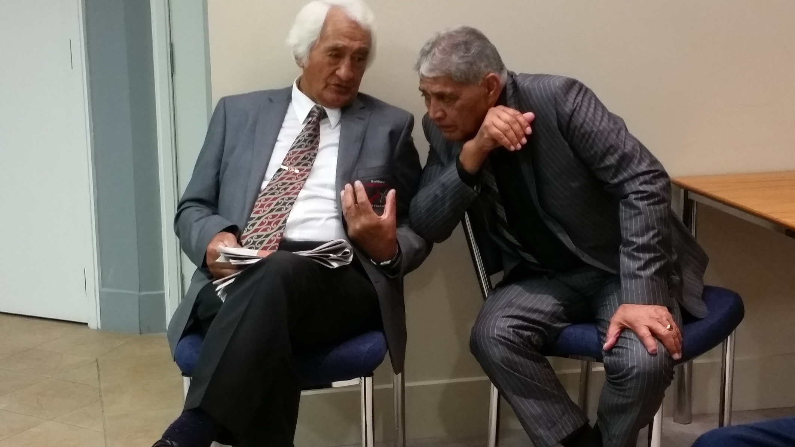
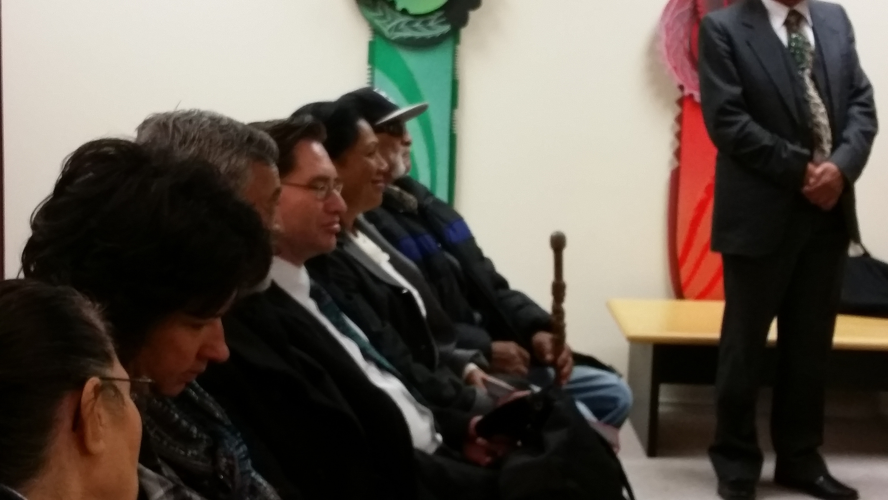
CLAIM BACKGROUND
  Wharere Farm litigation in Waitangi Tribunal, High Court, Court of Appeal and Supreme Court from 2013 to 2017
  Between 2019 and 2022 additional research on customary interests and historical claims

Slide 22
LATEST UPDATES
November, 2022
Crown agreed to enter direct negotiations
January, 2023
Ngāti Whakahemo reaffirmed mandate for Ngāti Whakahemo Claims Committee at a Special Hui with Te Arawhiti officials, here in Pukehina
November, 2023
Draft mandate strategy sent to Te Arawhiti

Slide 23
LATEST UPDATES
December, 2023
Te Arawhiti response
February, 2024
Hui in Wellington
March, 2024 -
September, 2024
Further amendments in response to Te Arawhiti comments
October, 2024
Final Approval from Te Arawhiti

Slide 24


HISTORICAL CLAIMS
WAI 1471
WAI 2536
Pukehina, Pongakawa, Waihi, Motunau and Motiti
Pongakawa, Waihi and Maketu
Any settlement will include WAI 1471, WAI 2536 and every other pre-1992 claim
Te Arawhiti maintain that “non-Maruahaira” claims have been settled through Ngāti Pikiao

Slide 25
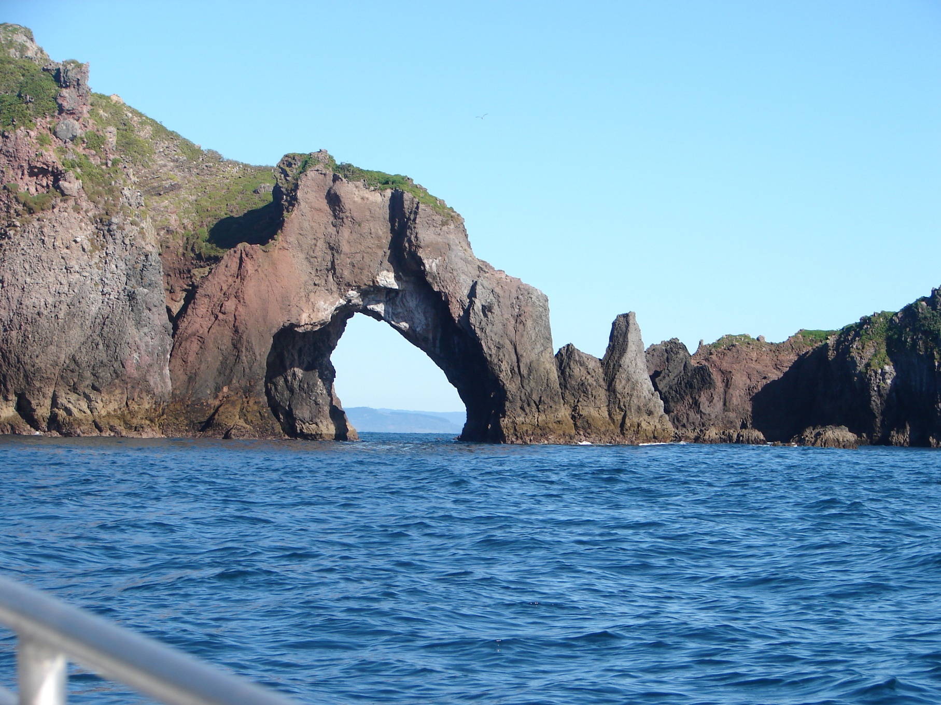
HISTORICAL CLAIMS
The historical claims cover:
  Native Land Court (Otamarakau, Pukehina, Kaikokopu, Pukeroa 2)
  Toa Claims (Tumu Kaituna, Maketu, Paengaroa, Pukaingataru, Whareama)
  Waiariki District Land Board
  Maketu Consolidation Scheme
  Wildlife Act (Motunau)
  Public Works Act
  Pukehina Development Scheme
  Environment (Waihi, Pongakawa, Wharere)

Slide 26
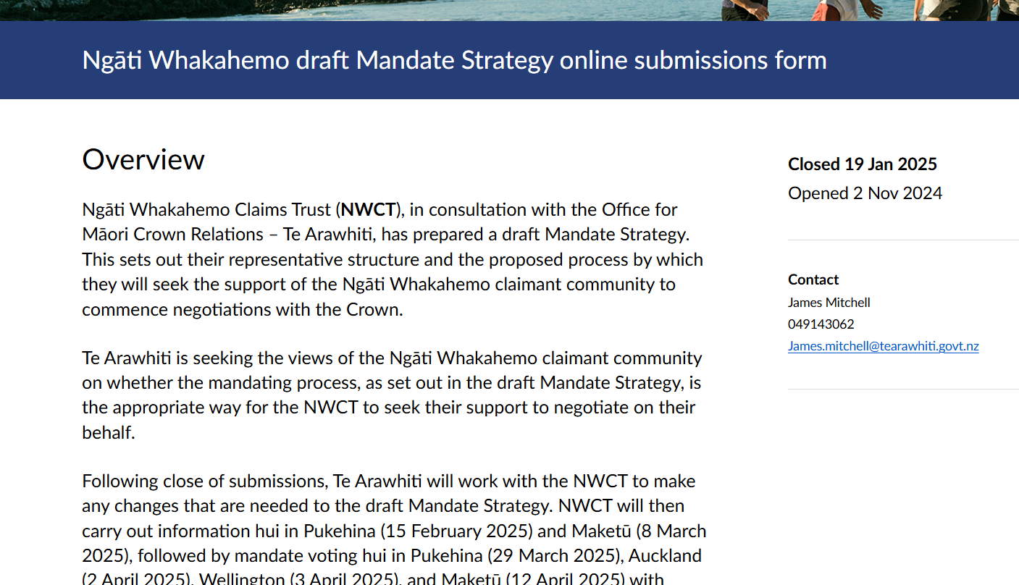

NGĀTI WHAKAHEMO
MANDATE STRATEGY
Crown requires mandate strategy that covers:
  Proposed mandate resolutions
  Definition of claimant group
  List of claims to be settled
  Area of interest
  Proposed hui and engagement with claimant group
  Financial accountability including separate bank account
  Appointment of negotiators
  Dispute resolution
You would have received a copy of our strategy via email.
2024
Ngāti Whakahemo Mandate Strategy

Slide 27
NGĀTI WHAKAHEMO CLAIMS TRUST
  Mandate of Ngāti Whakahemo Claims Committee reaffirmed at hui in January 2023
  Proposal to reconstitute claims committee as claims trust to comply with Crown requirements
  The claims trust will be the mandated entity to negotiate for and on behalf of the iwi of Ngāti Whakahemo
  The claims trust to be constituted under trust deed
  The claims trust will continue in operation until establishment of PSGE

Slide 28
NGĀTI WHAKAHEMO CLAIMS TRUST
Trust deed of trust based on PSGE template but adapted for Ngāti Whakahemo
Trust deed provides for:
  The tikanga of Ngāti Whakahemo to be the fundamental governing principle
  The existing members of claim committee to become the initial trustees
  The trustees to be subject to standard duties and obligations under Trusts Act 2019
  The trustees to appoint team of negotiators
  The establishment of Taumata Kaumātua to provide advice and guidance
  Register of adult members

Slide 29


PUBLIC NOTIFICATIONS
October, 2024
Te Arawhiti approved Mandate Strategy
November, 2024
Mandate Strategy publicly notified for submission. Submission period 1 November to 1 December 2024
Submissions received by Te Arawhiti
December, 2024
Extended notification and submission period from 16 December 2024 to 19 January 2025
Submissions received by Te Arawhiti -
21 of which were of support

Slide 30

PROPOSED RESOLUTIONS
The iwi of Ngāti Whakahemo approves the terms of trust for Ngāti Whakahemo Claims Trust as set out in the trust deed
The iwi of Ngāti Whakahemo gives Ngāti Whakahemo Claims Trust the mandate to represent Ngāti Whakahemo in negotiations with the Crown in respect of the full and final settlement of all Ngāti Whakahemo historical claims including WAI 1471 and WAI 2536

Slide 31

MANDATE HUI
10am
Saturday, 29 March
PUKEHINA MARAE
6pm
Wednesday, 2 April
JETPARK AIRPORT HOTEL, AUCKLAND
6pm
Thursday, 3 April
RYDGES AIRPORT HOTEL, WELLINGTON
6pm
Wednesday, 9 April
ONLINE VIA ZOOM
10am
Saturday, 12 April
MAKETU COMMUNITY HALL

Slide 32




HOW TO VOTE
in person:
Pukehina, Maketu, Auckland & Wellington
mail-in ballot:
via your Electionz.com voting pack
different ways for our Ngāti Whakahemo whānau cast their vote
online hui:
Held via ZOOM
online ballot:
link included in Electionz.com voting pack

Slide 33
HE WAIATA AROHA – NĀ NGĀTI WHAKAHEMO
Kaore te aroha e huri i runga ra o
Aku kiri kanohi, he hanga kia mapuna te
Roimata i aku kamo, e.
Me aha te aroha e mauru ai ra?
Mai ki pikitia te hira kai te Pare-o-te-
Rawahirua, kiamihi atu au te
Ripa ki Matawhau; naku ia nakoe ko-
I huri ki te tua, i.
Pere taku titiro te au kai te moana o
Tuhua i waho, he rerenga hipi mai no-
Hou, e Te Kiore, hei kawe i ahau ki
Tai o nga muri, kei maru tata'hau te
Whakamau ki te iwi e

Slide 34


